Slide 1

6. Manage servers with Server Manager
Windows Server 2019 Basics

Slide 2
Intro
Server Manager is a multi-server management tool included with Windows Server for free
It relies on the WinRM service to communicate with remote servers
Can configure and monitor different parts of Windows Server like roles, features, services…

Slide 3
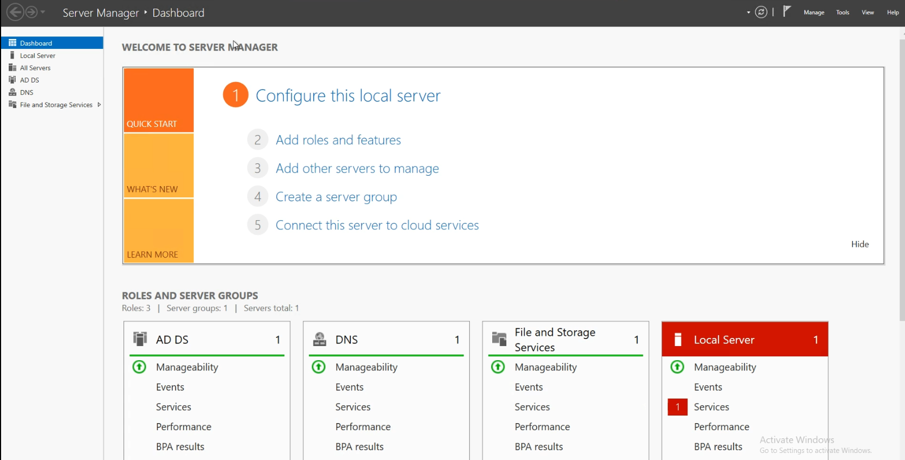
Server manager overview
Notes:
The server manager has 3 main parts:
- The menu which contains the address bas, the refresh button, the notifications pane and a couple of menus
- The left menu tab from where you can navigate through the Server Manager windows
- The main window that shows you the actual information; what is shown depends on what is selected in the left menu tab

Slide 4
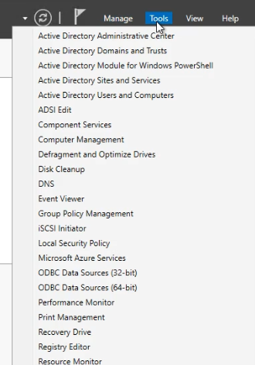
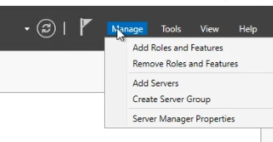
Server upper menu items
Notes:
From the Manage menu you can Install and remove Windows roles and features, add servers to the managed server list, create server groups and configure Server Manager itself
The Tools menu contains all of the Administration tools found on your Windows Server; these are not actually part of Server Manager but are just links to the specific MMC consoles

Slide 5
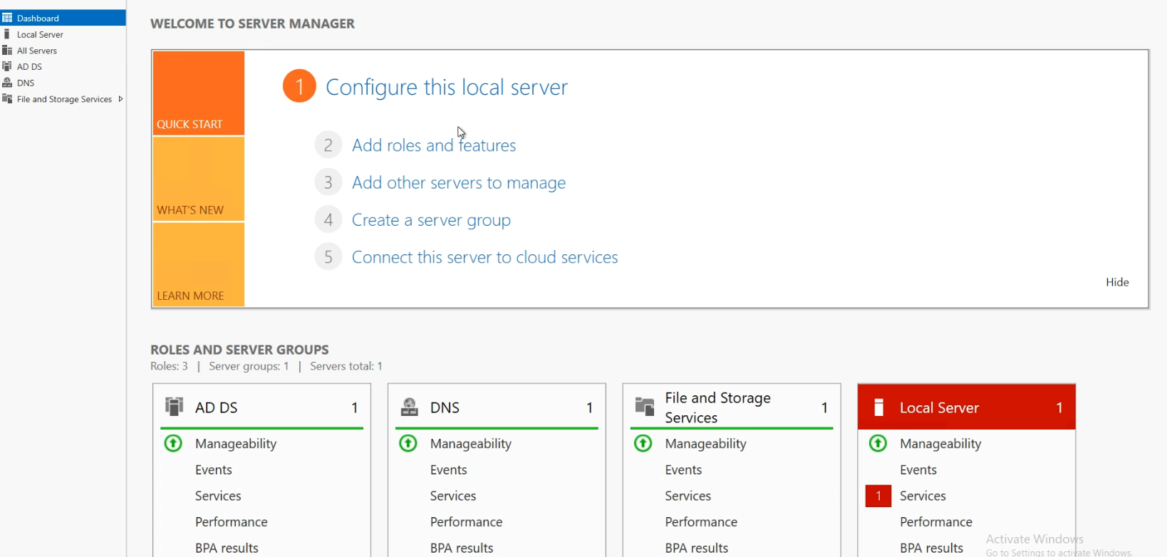
Dashboard
Notes:
In the Dashboard view you can find a Welcome to Server Manager tile which can be hidden since it is not that useful
Besides that tile, the Dashboard view also contains a thumbnail for each left pane menu item. The thumbnails show you if you have any errors in any of the items shown in their list plus the number of errors. In case there is at least an error on one of the thumbnails, that item’s title turns red and the place where the error was found has a red square with the error number in it

Slide 6
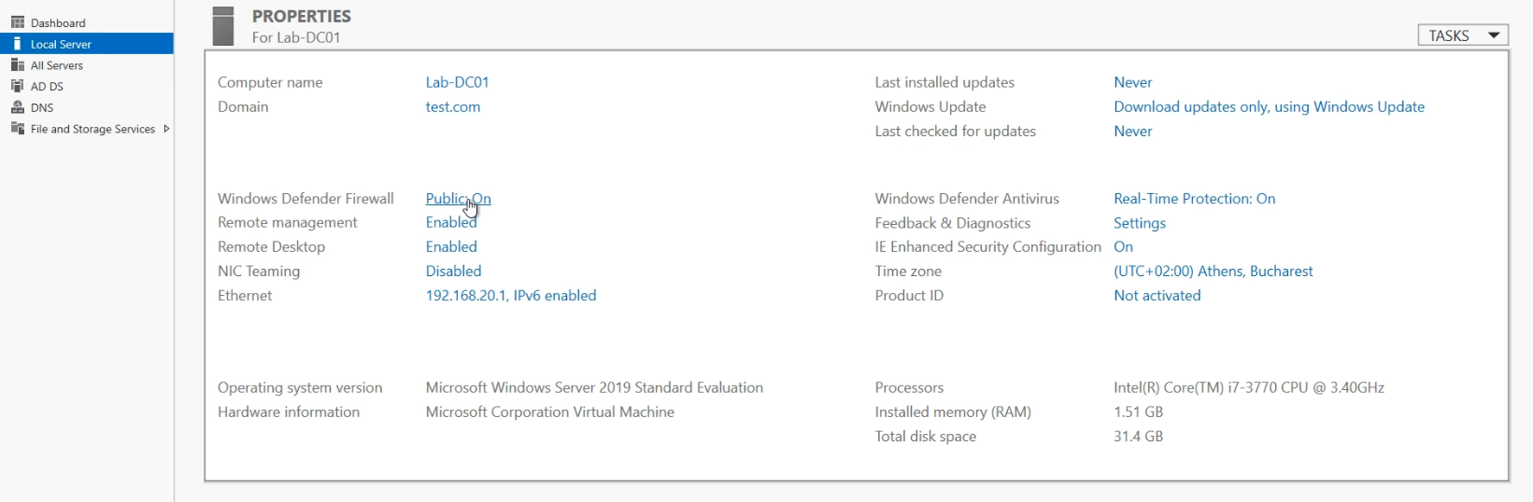
Local Server - properties
Notes:
In the Local Server page you have a couple of tiles from which you can configure the server on which the Server Manager is opened and also see events, best practices analysis and performance counters.
In the properties pane there are a couple of items that can be set like server name, domain or workgroup to join, firewall settings, IP settings and more.

Slide 7
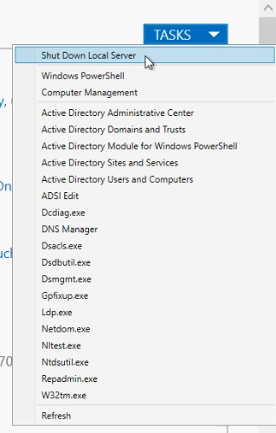
Local Server – properties (tasks)
Notes:
In the tasks menu you can also access a couple of MMC and CMD tools that are relevant to the server based on roles and features installed on it.

Slide 8
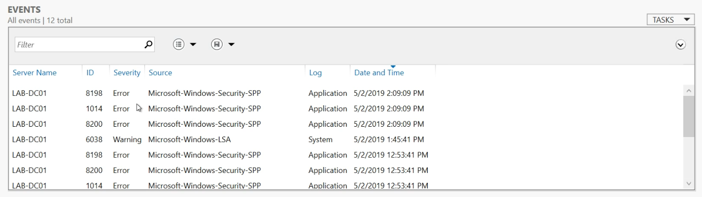
Local Server – Events
Notes:
Another tile is the Events tile. You can see all the relevant events on the server based on filters that you can set.

Slide 9
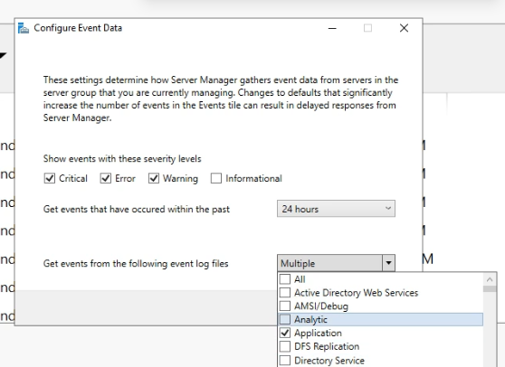
Local Server – Events (filters)
Notes:
The events shown in this tile can be filtered based on severity level, age and event source

Slide 10
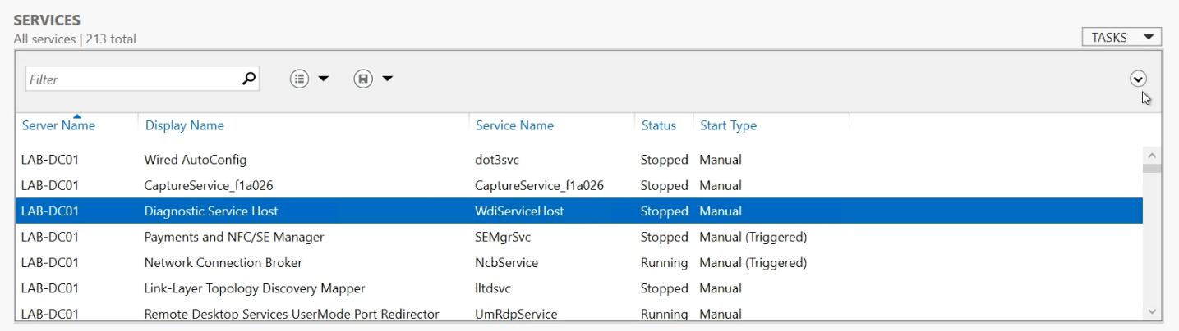
Local Server – Services
Notes:
In the services tile you can see a list of all services on the server along with their status and start type. Services can also be started, stopped and restarted from here

Slide 11
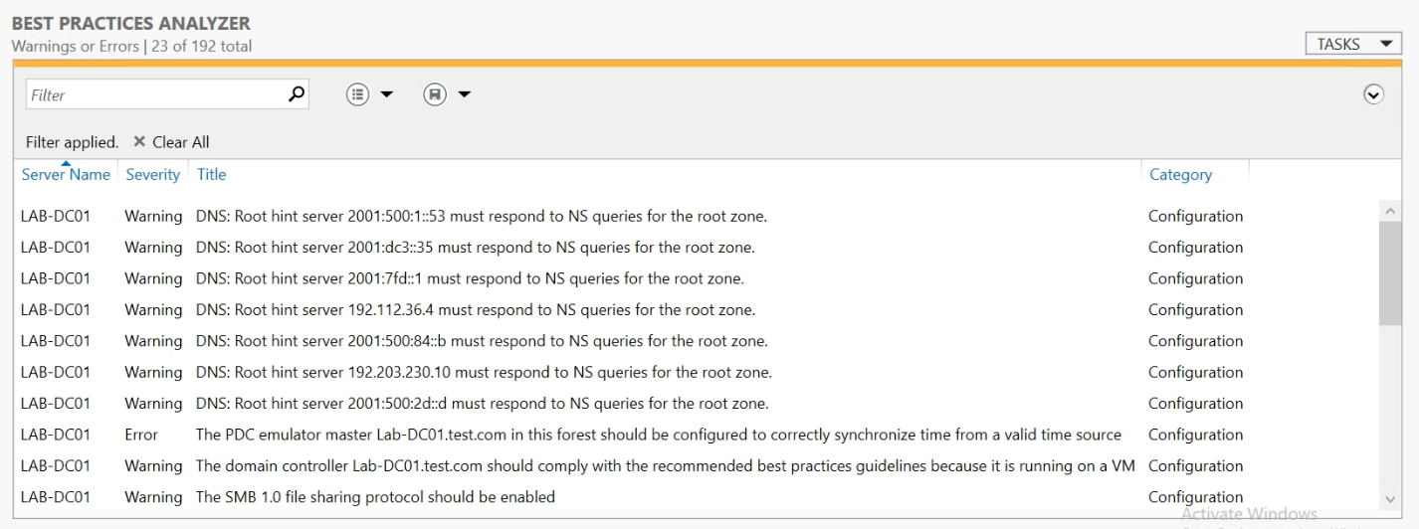
Local Server – Best Practices Analyzer
Notes:
In the Best Practices Analyzer tile you can start a BPA task on the server and get tips on what may not be configured 100% correctly and what to do in those cases

Slide 12
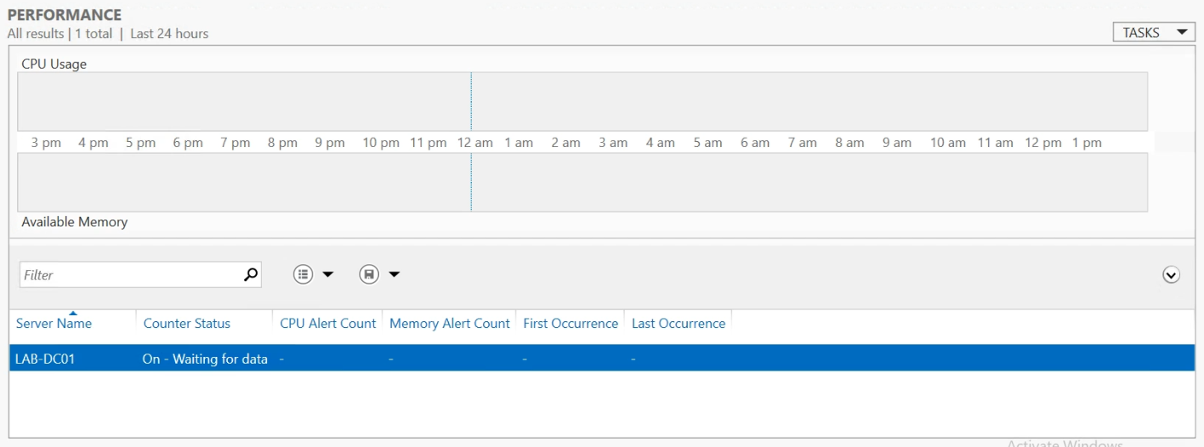
Local Server – Performance
Notes:
In the Performance tile you can see results of performance counters related to CPU and RAM. Limits can be set from the Tasks menu.

Slide 13
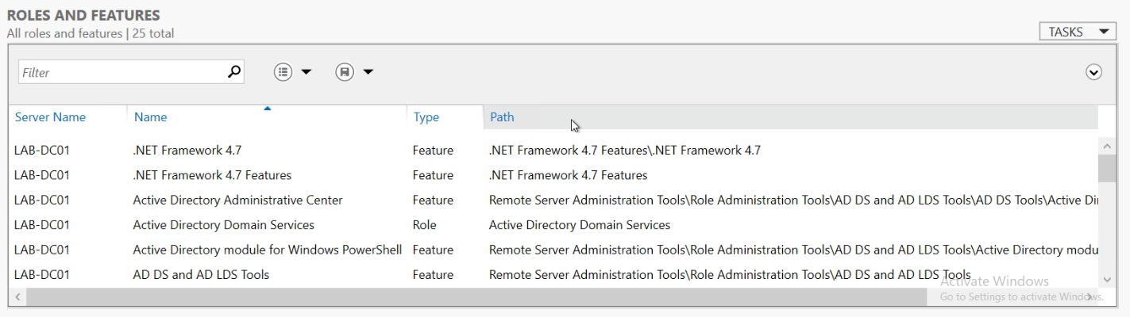
Local Server – Roles and Features
Notes:
In the Roles and Features tile you can see all the installed Roles and Features and you can also Remove them if this is needed

Slide 14
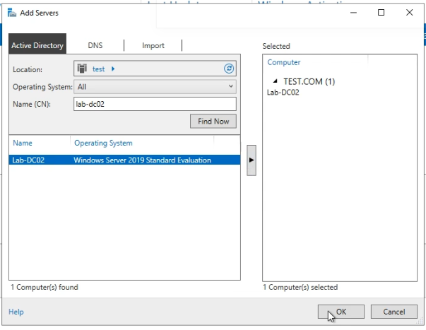

Adding servers to manage
Notes:
Server manager is a good tool not just because you can manage the local server, but because you can manage also remote servers.
To add another server to the managed list just Right click on the All servers menu item and select Add Servers
In the Window that opens just find the servers you want and add them to the list

Slide 15
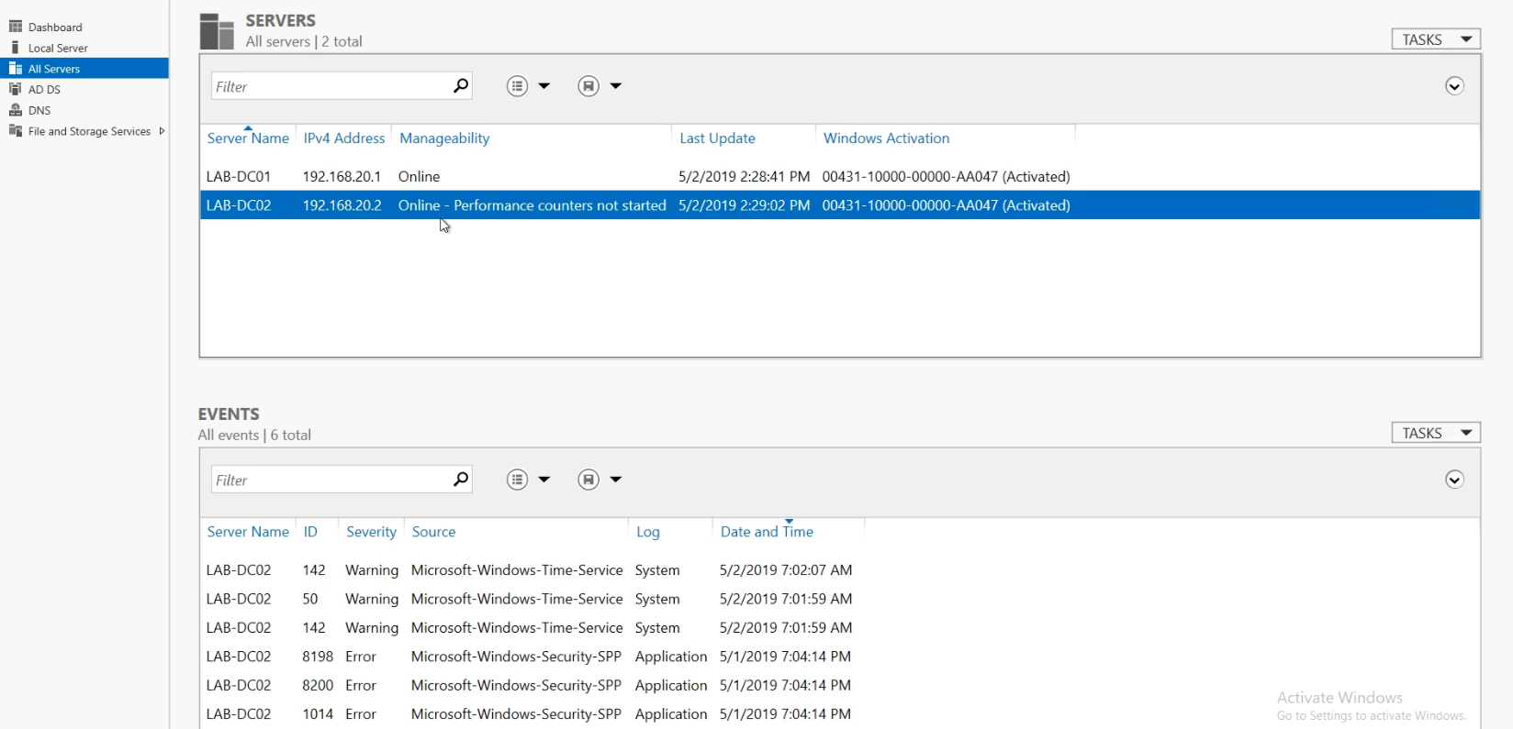
Multiple managed servers
Notes:
Once you have more than one server in the Server Manager you can see the list in the All Servers menu. When you select a server you can configure and see all items presented previously: roles, features, services, events and so on

Slide 16

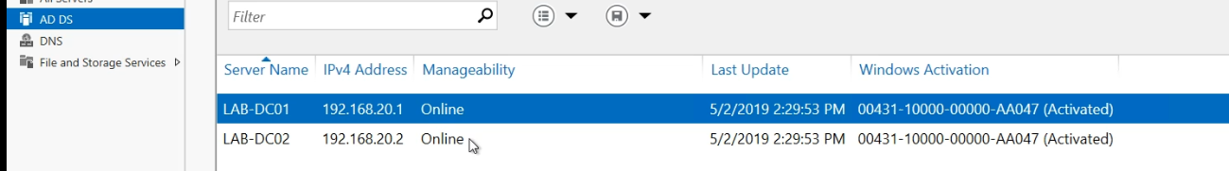
Dynamic Server groups
Notes:
Based on the roles and features that you managed servers have installed, new server groups will appear in the left menu. Each groups will contain only the servers that have the specific role installed
Once you click on one of those groups you will be presented with the same screen that you get on All servers but with filtered machines

Slide 17
Dynamic Server groups
Notes:
Based on the roles and features that you managed servers have installed, new server groups will appear in the left menu. Each groups will contain only the servers that have the specific role installed
Once you click on one of those groups you will be presented with the same screen that you get on All servers but with filtered machines

Slide 18
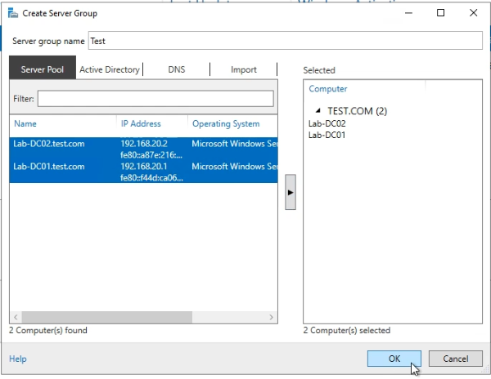
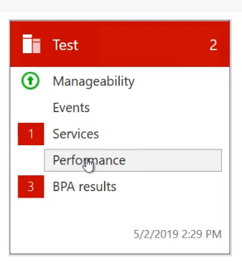
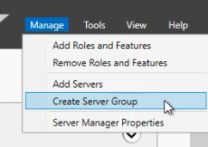
Create a Server group
Notes:
You can also create your own server groups. Just go to manage and select Create Server Group and in the new window just enter the group name and select the member servers
Any new group will also have a thumbnail created on the Dashboard view

Slide 19
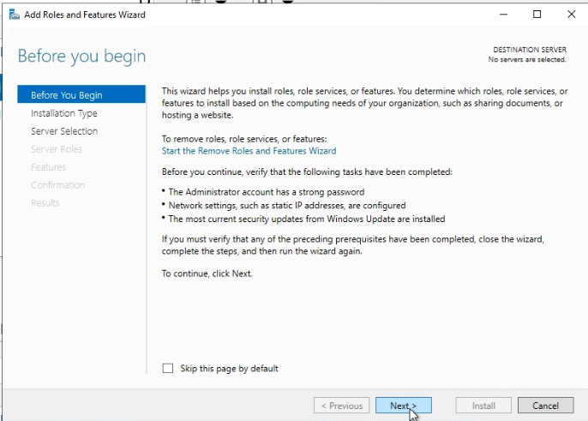
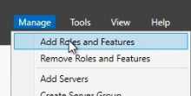
Install server Roles and Features
Notes:
One of the big things you can do from Server Manager is the installation and removal of roles and features.
To install roles and features just select Add Roles and Features from the Manage menu item and just press Next in the first Window that comes up

Slide 20
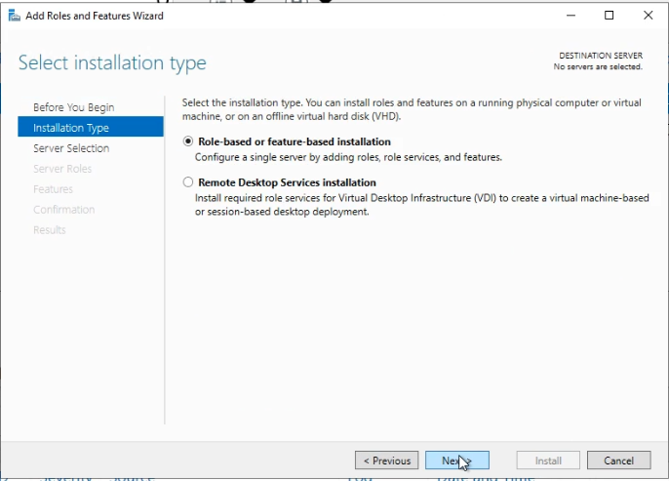
Install server Roles and Features
Notes:
In this window you have the option to install normal Roles and Features or roles that have to do with Remote Desktop Services

Slide 21
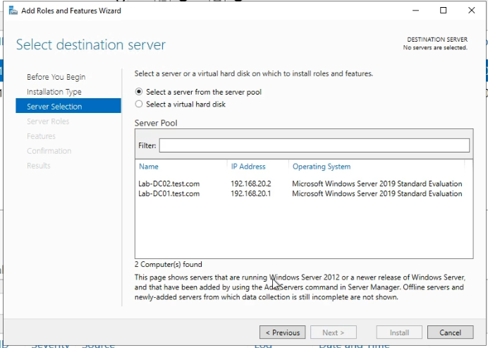
Install server Roles and Features
Notes:
You can either select one of the managed servers to install the roles and features on, or make the installation on an offline VHD/VHDX image

Slide 22
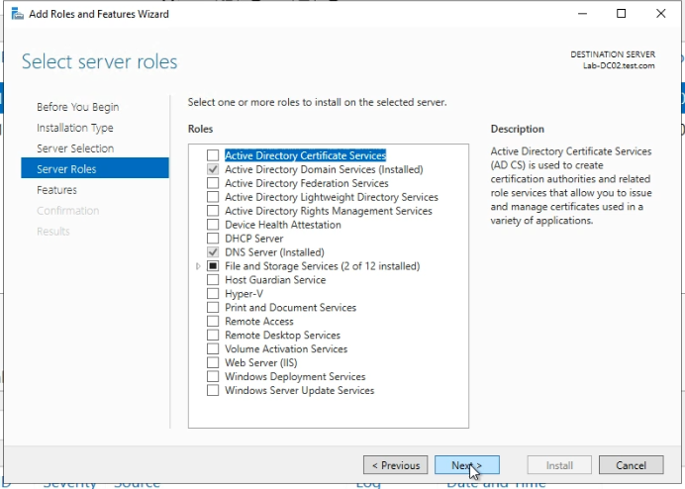
Install server Roles and Features
Notes:
You can select the Roles in this screen

Slide 23
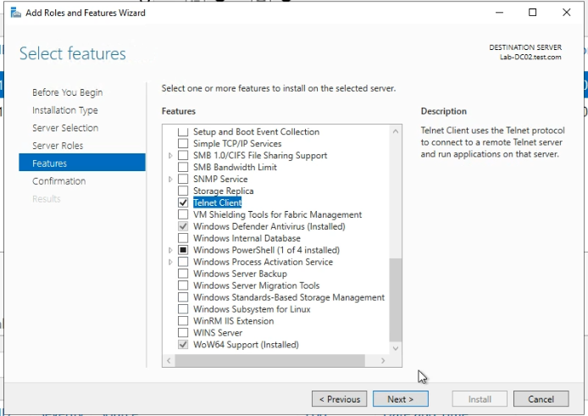
Install server Roles and Features
Notes:
You can select the Features in this screen

Slide 24
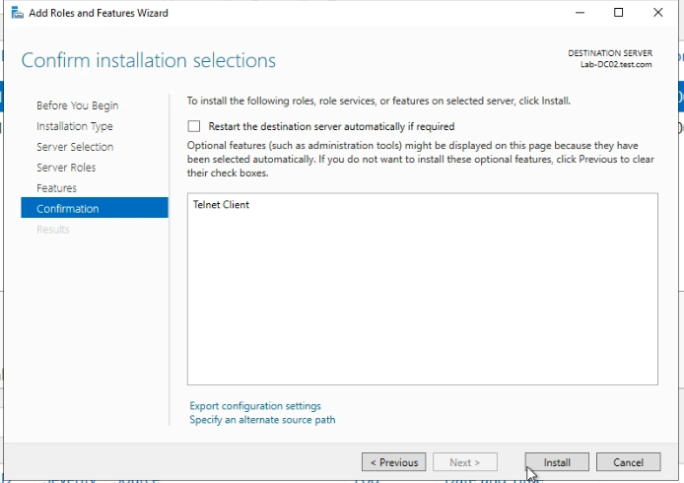
Install server Roles and Features
Notes:
From this screen you can select if the server auto-restarts in case it needs to after the role/feature installation

Slide 25
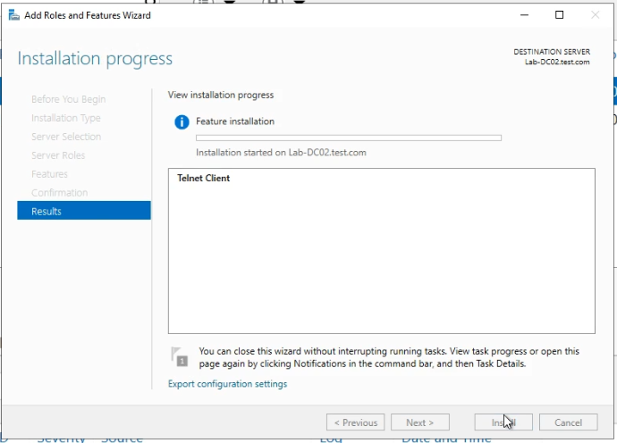
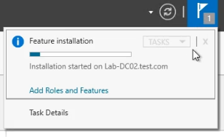
Install server Roles and Features
Notes:
You can close this window if you want; the installation is in the background
The status of the installation can be seen also in the Notifications pane

Slide 26
https://www.youtube.com/channel/UCcZ-jLbPwNr8E_v9-65n8Iw https://github.com/itknowledge4

